Slide 1
ACIT 1620 - FUNDAMENTAL WEB TECHNOLOGIES
WEEK 6
NEDA CHANGIZI

Slide 2
Today’s Learning Outcomes
Use CSS combinator selectors to select and style elements based on their location in the document.
Utilize appropriate pseudo-class selectors to select elements that are in a specific state.
Use appropriate pseudo-element selectors to select specified parts of an element.
Demonstrate how conflicting rules are resolved in CSS using the concepts of cascade, specificity, and inheritance.
Use CSS float and position properties to customize the location of objects on a page.
4

Slide 3
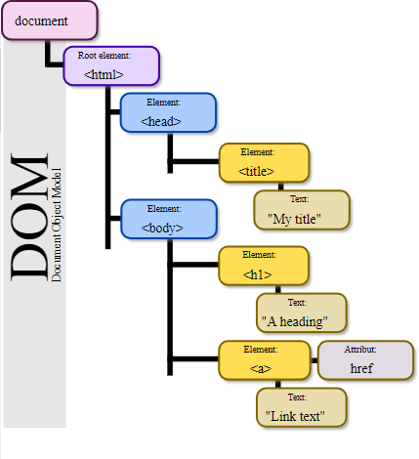
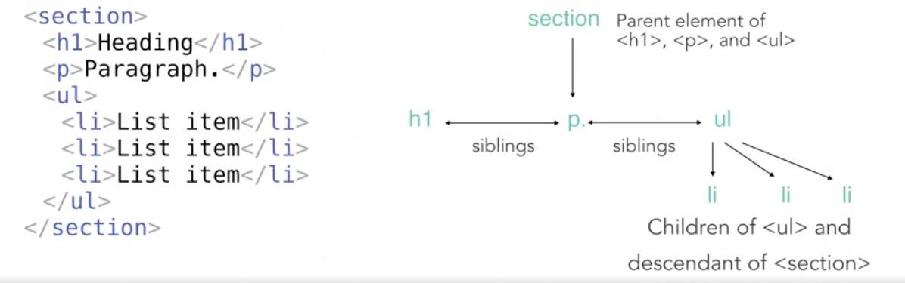
Remember Document Object Model (DOM)?
When a web page is loaded, the browser creates
a Document Object Model of the page.
Notice the tree-like structure of DOM model.
Note: children are still considered as descendants:
4

Slide 4

CSS Combinator selectors
Apply styles based on the location of an element in a document
Selector | Example | Example description
Descendant selector element element | div p | Selects all <p> elements inside <div> elements
Child selector element > element | div > p | Selects all <p> elements where the parent is a <div> element
Adjacent sibling selector element + element | div + p | Selects all <p> elements that are placed immediately after <div> elements
General sibling selector element1 ~ element2 | p ~ ul | Selects every <ul> element that are preceded by a <p> element
4

Slide 5
Combinator – Activity
<h2>This is a heading</h2>
<div class="container">
<h2>This is another heading</h2>
<p>This paragraph comes after the heading.</p>
<p>This is the second paragraph.</p>
<h2>Another heading</h2>
<p>This paragraph comes after the heading.</p>
<ul class="list">
<li>One</li>
<li>Two
<ul>
<li>2.1</li>
<li>2.2</li>
</ul>
</li>
</ul>
</div>
Add a CSS rule to make all the h2 elements inside the div italic
Add a CSS rule to make any paragraph that directly follows an h2 red.
Remove the bullets and add a 1px solid grey bottom border only to list items that are a direct child of the ul with a class of list.
5

Slide 6
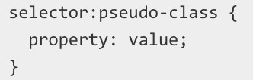
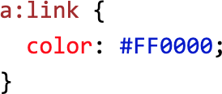
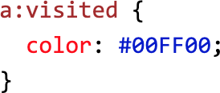
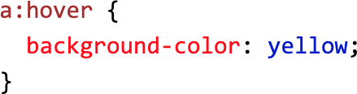
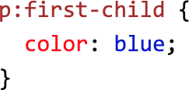
CSS Pseudo-class Selectors
Style elements based on their state
Example of pseudo-classes:
:link
:visited
:focus
:hover
:active
:checked
:first-child
6
Index of standard pseudo-classes

Slide 7
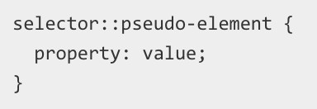
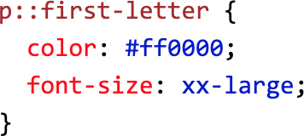
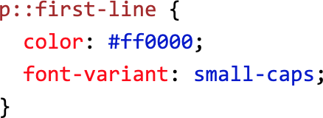
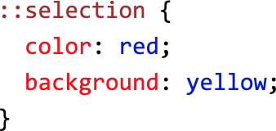
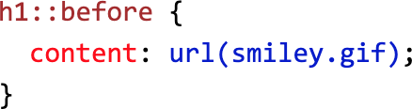
CSS Pseudo-element Selectors
Style a specific part of the selected element(s):
Examples:
::after
::before
::first-line
::first-letter
::selection
Index of standard pseudo-elements
7

Slide 8
Pseudo-class, pseudo-element, and attribute Selector – Activity
Without changing the HTML code, add CSS rules to:
Make all the links inside a list item green in unvisited state, red when visited, and pink when hover.:
Note: a:hover MUST come after a:link and a:visited in the CSS definition in order to be effective!
Make the first letter of the first list item bold and 120% in size.
Using attribute selector, give a yellow background to the “BCIT homepage” hyperlinked text
<a title="BCIT homepage" href="https://bcit.ca">Links</a>
<ul>
<li><a title ="programs" href="https://www.bcit.ca/study/">Programs</a></li>
<li><a title ="admission" href="https://www.bcit.ca/admission">Admission</a></li>
</ul>

Slide 9
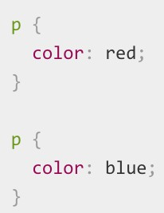
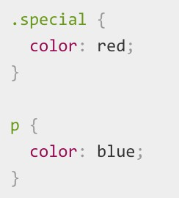

WHAT HAPPENS WHEN TWO SELECTORS COULD SELECT THE SAME HTML ELEMENT? (CONFLICTING RULES)
Cascade rule:
Specificity rule:

Slide 10
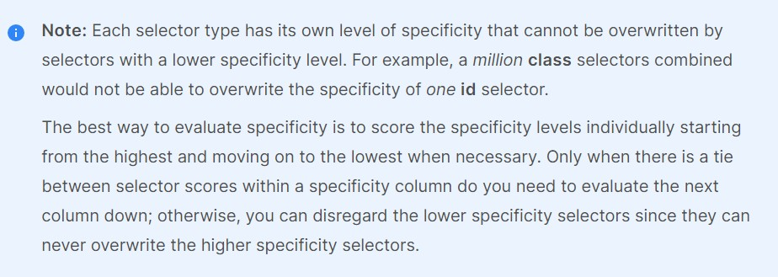
SPECIFICITY

Slide 11
CSS Inheritance – Activity
<ul class="main">
<li>Item One</li>
<li>Item Two
<ul>
<li>2.1</li>
</ul>
</li>
<li>Item Three
<ul class="special">
<li>3.1
<ul>
<li>3.1.1</li>
</ul>
</li>
<li>3.2</li>
</ul>
</li>
<li>Item Four</li>
</ul>
What color do you expect “2.1” to be?
Are border and padding properties inherited?
Add a CSS rule to make everything nested under
”Item Three” rendered in green.
What color do you expect “Item Four” to be?
.main {
color: rebeccapurple; border: 2px solid #ccc; padding: 1em;
}
11

Slide 12
Cascading and Specificity – Activity
What happens if you update the previous example with this internal styling?
<head>
<link rel="stylesheet" type="text/css" href="css/stylesheet.css">
<style>
.main {
color: orange;
}
</style>
</head>
What happens if you change the order of <link> and <style> tags?
Now add an inline style with color: teal for the ul element with class=“main”. How do you expect the
colors of the list items to change?
12

Slide 13
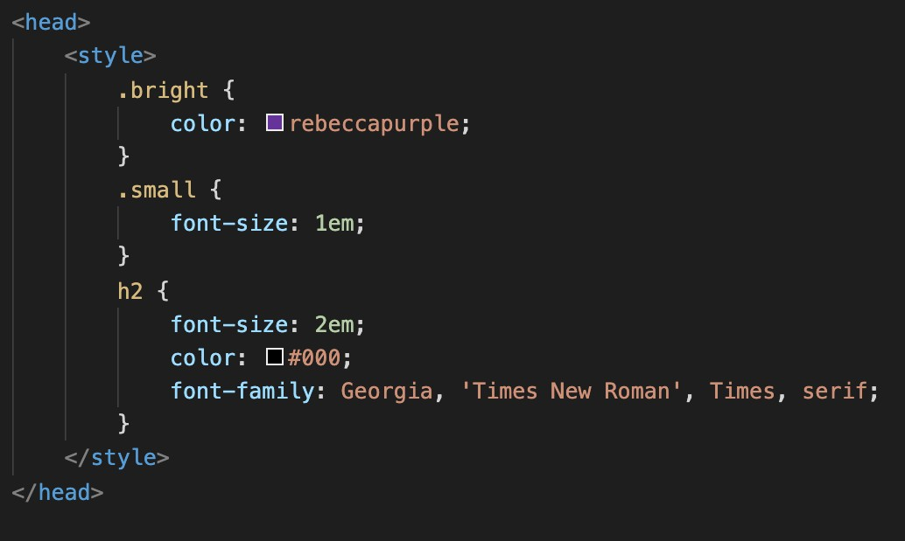
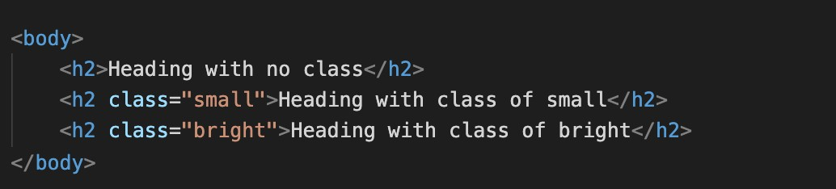
CSS Selector Specificity – Example
What color do you expect the h2 with class small to be?
What font-size do you expect the h2 with
class bright to be?

Slide 14
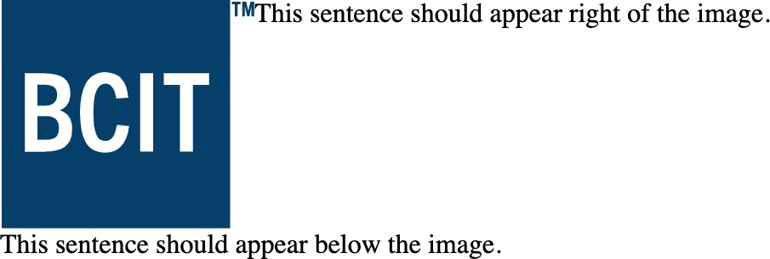
CSS float property
Use float and clear properties to style this HTML code as rendered:
<img src="https://upload.wikimedia.org/wikipedia/commons/6/6f/BCIT_logo.svg" alt="BCIT logo" width="150" height="136">
<p>This sentence should appear right of the image.</p>
<p class="below"> This sentence should appear below the image.</p>
Where are the boundaries of the first paragraph?

Slide 15

CSS – Position
Codepen demo
the following CSS code to move the green div to the top right corner of the gray box:
.target{ width:50px; height:50px;
background-color: forestgreen;
}
<div class="container">
<p>My first paragraph.</p>
<div class="target">Target</div>
<p>My second paragrpah</p>
</div>
.container
{
border: 2px gray solid;
}

